Slide 1


Rafael Bilhão
August 1st, 2025

Slide 2

Outline
Executive Summary
Introduction
Methodology
Results
Conclusion
Appendix

Slide 3
Executive Summary
This project aims to predict the success of SpaceX rocket launches. Data was collected from the SpaceX REST API and web scraping. After data wrangling and exploratory data analysis (EDA) using SQL and visualizations, we built and evaluated several classification models. The results indicate that launch site, payload mass, and orbit type are significant factors in determining launch success. An interactive dashboard was also developed to visualize these findings.

Slide 4
Introduction
Project Background: SpaceX has revolutionized the space industry with reusable rockets, significantly reducing launch costs. Analyzing historical launch data can provide valuable insights for future missions.
Problem Statement: The primary goal is to build a machine learning model that can accurately predict if a Falcon 9 first stage will land successfully. This can help in determining the cost-effectiveness of a launch.

Slide 5

Section 1

Slide 6
Methodology
Executive Summary
Data collection: Gathering data from the SpaceX API and a Wikipedia page.
Data wrangling: Cleaning and preprocessing the collected data.
Exploratory Data Analysis (EDA): Using SQL and Python libraries to uncover patterns and relationships.
Interactive Visual Analytics: Building interactive maps with Folium and a dashboard with Plotly Dash.
Predictive Analysis: Building, tuning, and evaluating classification models to predict launch success.

Slide 7
Data Collection – SpaceX API
Process: Data was collected using the SpaceX REST API to gather information about launches, cores, payloads, and launchpads.
Flow:
Made GET requests to various API endpoints (e.g., /launches, /rockets, /payloads).
Extracted relevant data fields from the JSON responses.
Normalized the JSON data into flat pandas DataFrames.
Filtered for Falcon 9 launches.
HTTP GET Request to a SpaceX API endpoint (e.g., /launches)
Receive JSON Response
Normalize JSON using pandas.json_normalize()
Select & Filter Data: Keep only the necessary columns and filter the data
Create DataFrame
Repeat for other endpoints?
If yes, loop back to the GET request step. If no, proceed.
Reference: SpaceX API.ipynb

Slide 8
Data Collection - Scraping
Process: Historical launch data was scraped from a Wikipedia page listing Falcon 9 and Falcon Heavy launches.
Flow:
Used the requests library to download the HTML content of the page.
Utilized BeautifulSoup to parse the HTML and locate the main launch table.
Iterated through table rows (<tr>) and cells (<td>) to extract launch information.
Cleaned and structured the extracted text into a pandas DataFrame.
HTTP GET Request to get the HTML content of the target Wikipedia page
Parse HTML with BeautifulSoup to make it searchable
Locate the specific <table> element that contains the Falcon 9 launch history.
Iterate through each row (<tr>) of the identified table.
Extract Data from Cells (<td>)
Append the extracted information for each launch into a list
Create DataFrame
Reference: Web scraping.ipynb

Slide 9
Data Wrangling
Process: The datasets from the API and web scraping were cleaned, merged, and prepared for analysis.
Key Steps:
Identified and handled missing values across the dataset.
Created the target variable Class (1 for success, 0 for failure) based on the Outcome column.
Calculated the number of launches for each launch site.
Filtered and standardized data formats.
Reference: Data wrangling.ipynb

Slide 10
EDA with Data Visualization
Summary: Plotted various charts to understand the relationship between launch attributes and success.
Charts Used:
Scatter Plot (Flight Number vs. Launch Site): To see if launch frequency increased over time for different sites.
Scatter Plot (Payload vs. Launch Site): To analyze payload distribution per site.
Bar Chart (Success Rate vs. Orbit Type): To identify which orbits have the highest success rates.
Reference: EDA with Data Visualisation.ipynb.ipynb

Slide 11
EDA with SQL
Summary: Performed SQL queries on the dataset loaded into a SQLite database to answer specific analytical questions.
Queries Performed:
Find unique launch sites.
Display the first 5 records where launch sites start with 'CCA’.
Calculate the total payload mass carried by boosters from NASA (CRS).
Find the average payload mass for the F9 v1.1 booster version.
List the dates of the first successful ground pad landings.
Rank landing outcomes between 2010-06-04 and 2017-03-20.
Reference: EDA with SQL.ipynb

Slide 12
Build an Interactive Map with Folium
Summary: Created an interactive map to visualize the locations of SpaceX launch sites.
Objects Added:
Markers: Placed markers on each launch site's coordinates.
Circles: Added circles around each site with colors indicating launch success or failure.
Lines: Drew lines to calculate the distance from launch sites to nearby coastlines and railways.
Purpose: To visually explore the geographic context of launch sites and their proximity to important infrastructure.
Reference: Interactive Maps with Folium.ipynb

Slide 13
Build a Dashboard with Plotly Dash
Summary: Developed an interactive dashboard to explore launch data dynamically.
Plots and Interactions:
A dropdown menu to select different launch sites.
A pie chart showing the total successful launches for each site.
A scatter plot visualizing the relationship between payload mass and launch outcome, with a range slider to filter payload mass.
Purpose: To allow users to interactively filter and explore the data, gaining deeper insights into success factors.
Reference: spacex-dash-app.py

Slide 14
Predictive Analysis (Classification)
Process:
Feature Engineering:
One-hot encoded categorical features like LaunchSite and Orbit.
Data Splitting: Split the data into training and testing sets.
Model Building: Trained four different classification models:
Logistic Regression, SVM, Decision Tree, and K-Nearest Neighbors (KNN).
Hyperparameter Tuning: Used GridSearchCV to find the best parameters for each model.
Evaluation: Compared model performance using accuracy and a confusion matrix.
Reference: SpaceX Machine Learning Prediction.ipynb

Slide 15
Results
Exploratory data analysis results
Interactive analytics demo in screenshots
Predictive analysis results

Slide 16

Section 2

Slide 17
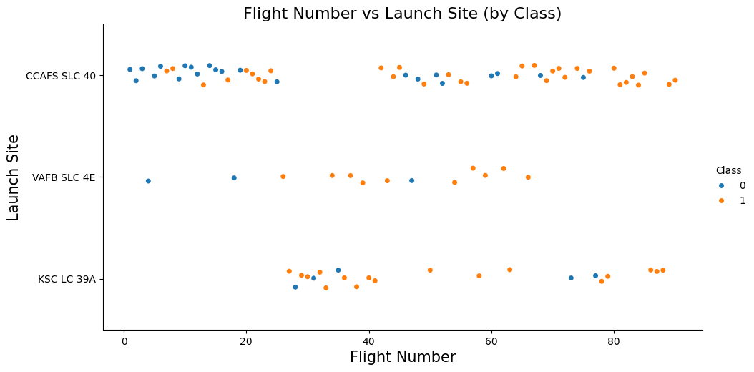
Flight Number vs. Launch Site
Explanation: This plot shows the progression of flight numbers for each launch site. We can observe that certain sites, like KSC LC-39A, have been used more frequently in recent launches.

Slide 18
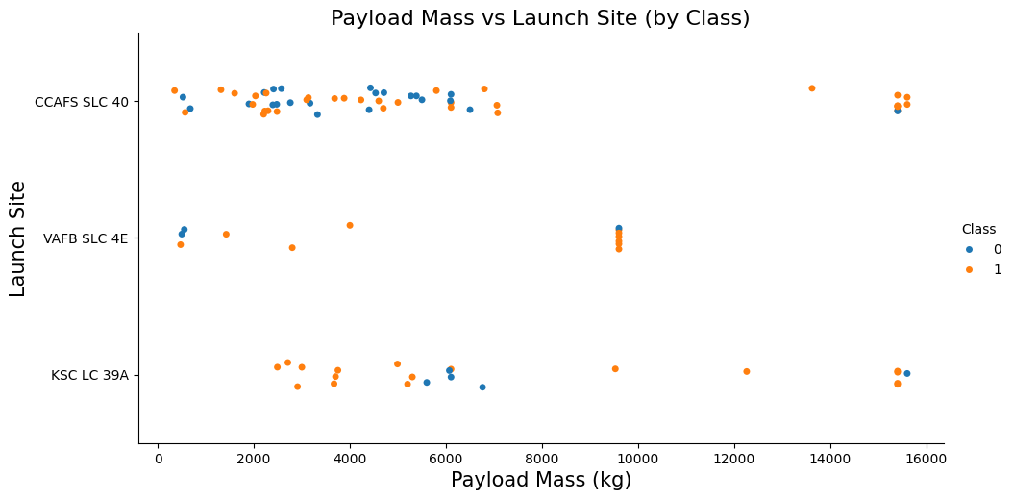
Payload vs. Launch Site
Explanation: This scatter plot visualizes the payload mass for launches from each site. It helps identify if certain sites are used for launches with heavier payloads.

Slide 19
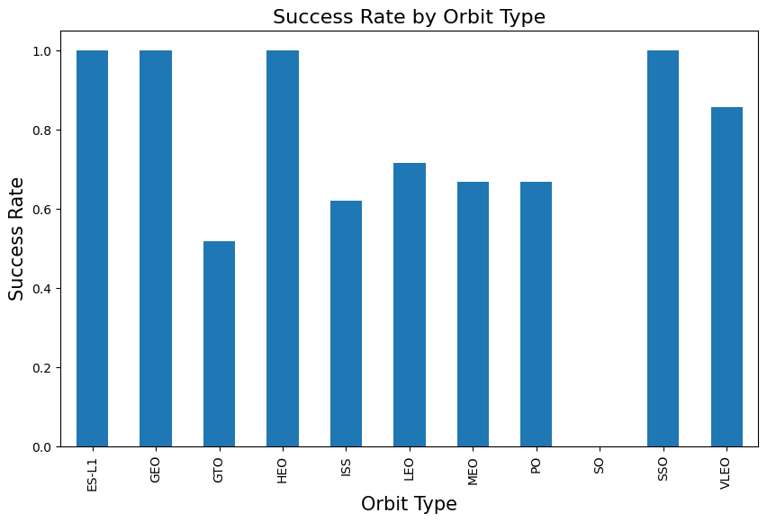
Success Rate vs. Orbit Type
Explanation: This bar chart displays the success rate for different orbit types. Orbits like ES-L1, GEO, HEO, and SSO have a higher success rate, indicating that the destination orbit is a key factor in the outcome of a launch.

Slide 20
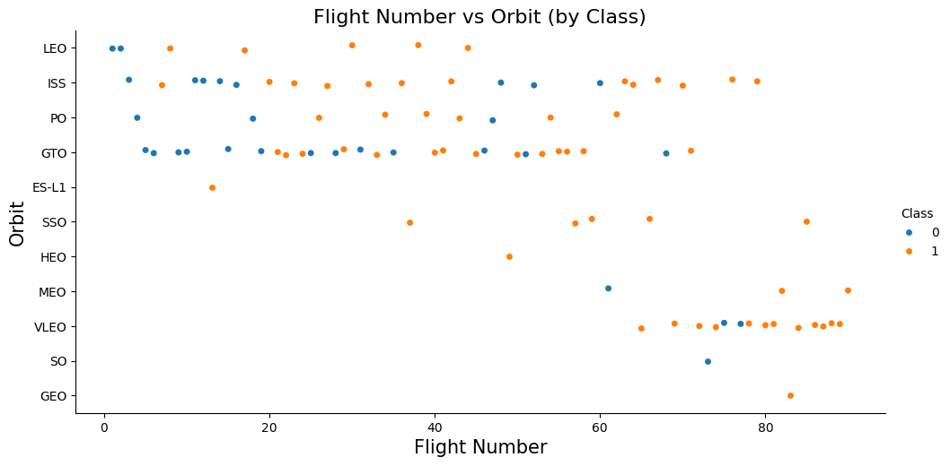
Flight Number vs. Orbit Type
Explanation: This scatter plot indicates that in the LEO orbit, success seems to be related to the number of flights. Conversely, in the GTO orbit, there appears to be no relationship between flight number and success.

Slide 21
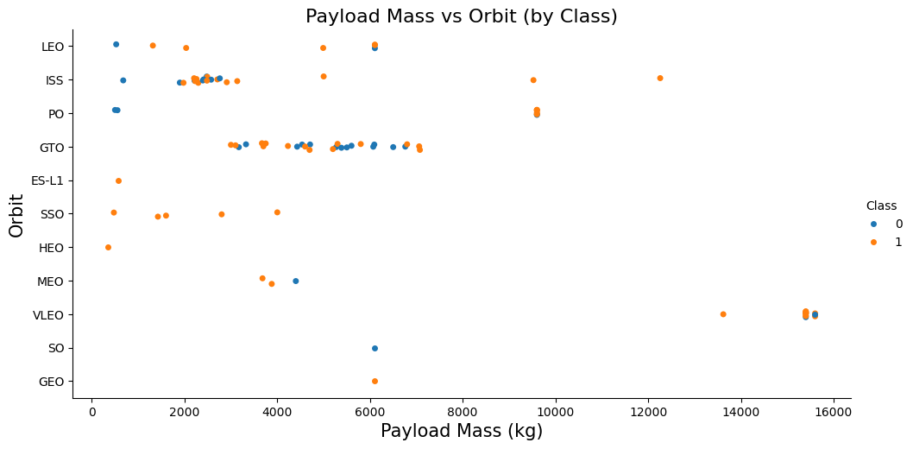
Payload vs. Orbit Type
With heavy payloads the successful landing rate are more for Polar, LEO and ISS.
However, for GTO, it's difficult to distinguish between successful and unsuccessful landings as both outcomes are present.

Slide 22
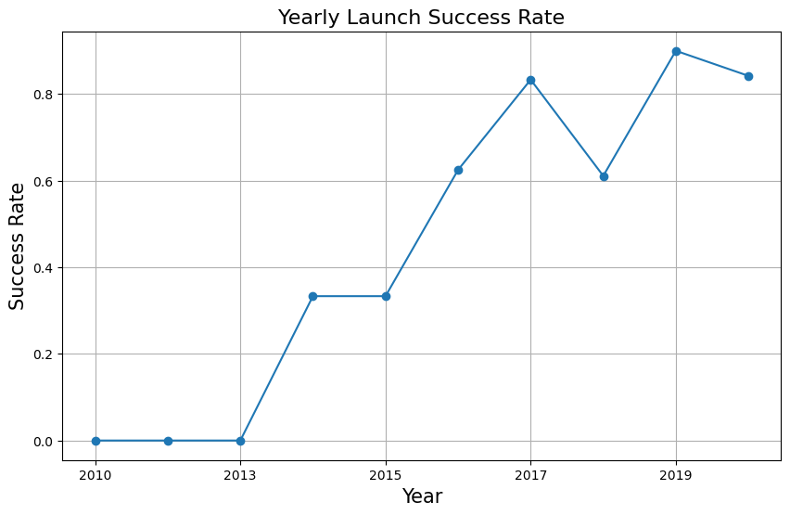
Launch Success Yearly Trend
The success rate since 2013 kept increasing till 2020

Slide 23
All Launch Site Names
Query: SELECT DISTINCT Launch_Site FROM SPACEXTABLE;
Launch_Site
CCAFS LC-40
VAFB SLC-4E
KSC LC-39A
CCAFS SLC-40
Shows the unique launch sites: CCAFS LC-40, VAFB SLC-4E, KSC LC-39A, CCAFS SLC-40.

Slide 24
Launch Site Names Begin with 'CCA'
Query: SELECT * FROM SPACEXTABLE WHERE Launch_Site LIKE 'CCA%' LIMIT 5;
Date | Time (UTC) | Booster_Version | Launch_Site | Payload | PAYLOAD_MASS__KG_ | Orbit | Customer | Mission_Outcome | Landing_Outcome
2010-06-04 | 18:45:00 | F9 v1.0 B0003 | CCAFS LC-40 | Dragon Spacecraft Qualification Unit | 0 | LEO | SpaceX | Success | Failure (parachute)
2010-12-08 | 15:43:00 | F9 v1.0 B0004 | CCAFS LC-40 | Dragon demo flight C1, two CubeSats, barrel of Brouere cheese | 0 | LEO (ISS) | NASA (COTS) NRO | Success | Failure (parachute)
2012-05-22 | 7:44:00 | F9 v1.0 B0005 | CCAFS LC-40 | Dragon demo flight C2 | 525 | LEO (ISS) | NASA (COTS) | Success | No attempt
2012-10-08 | 0:35:00 | F9 v1.0 B0006 | CCAFS LC-40 | SpaceX CRS-1 | 500 | LEO (ISS) | NASA (CRS) | Success | No attempt
2013-03-01 | 15:10:00 | F9 v1.0 B0007 | CCAFS LC-40 | SpaceX CRS-2 | 677 | LEO (ISS) | NASA (CRS) | Success | No attempt
Shows 5 records where the Launch Site Names begin with ‘CCA’

Slide 25
Total Payload Mass
Query: SELECT SUM(PAYLOAD_MASS__KG_) FROM SPACEXTABLE WHERE Customer = 'NASA (CRS)'
SUM(PAYLOAD_MASS__KG_)
45596
Calculate the total payload carried by boosters from NASA

Slide 26
Average Payload Mass by F9 v1.1
Query: SELECT AVG(PAYLOAD_MASS__KG_) FROM SPACEXTABLE WHERE Booster_Version = 'F9 v1.1';
AVG(PAYLOAD_MASS__KG_)
2928.4
Calculate the average payload mass carried by booster version F9 v1.1

Slide 27
First Successful Ground Landing Date
Query: SELECT MIN(Date) FROM SPACEXTABLE WHERE Landing_Outcome = 'Success (ground pad)';
MIN(Date)
2010-06-04
Find the dates of the first successful landing outcome on ground pad

Slide 28
Successful Drone Ship Landing with Payload between 4000 and 6000
Query: SELECT Booster_Version FROM SPACEXTABLE WHERE Landing_Outcome = 'Success (drone ship)' AND PAYLOAD_MASS__KG_ > 4000 AND PAYLOAD_MASS__KG_ < 6000;
Booster_Version
F9 FT B1022
F9 FT B1026
F9 FT B1021.2
F9 FT B1031.2
List the names of boosters which have successfully landed on drone ship and had payload mass greater than 4000 but less than 6000

Slide 29
Total Number of Successful and Failure Mission Outcomes
Query: SELECT Landing_Outcome, COUNT(*) AS OutcomeCount FROM SPACEXTABLE GROUP BY Landing_Outcome;
Landing_Outcome | OutcomeCount
Controlled (ocean) | 5
Failure | 3
Failure (drone ship) | 5
Failure (parachute) | 2
No attempt | 21
No attempt | 1
Precluded (drone ship) | 1
Success | 38
Success (drone ship) | 14
Success (ground pad) | 9
Uncontrolled (ocean) | 2
Calculate the total number of successful and failure mission outcomes

Slide 30
Boosters Carried Maximum Payload
Booster_Version
F9 B5 B1048.4
F9 B5 B1049.4
F9 B5 B1051.3
F9 B5 B1056.4
F9 B5 B1048.5
F9 B5 B1051.4
F9 B5 B1049.5
F9 B5 B1060.2
F9 B5 B1058.3
F9 B5 B1051.6
F9 B5 B1060.3
F9 B5 B1049.7
Query: SELECT Booster_Version FROM SPACEXTABLE WHERE PAYLOAD_MASS__KG_ = (SELECT MAX(PAYLOAD_MASS__KG_) FROM SPACEXTABLE);
List the names of the booster which have carried the maximum payload mass

Slide 31
2015 Launch Records
Query: SELECT substr(Date,6,2) AS Month, Landing_Outcome, Booster_Version, Launch_Site FROM SPACEXTABLE WHERE Landing_Outcome LIKE 'Failure (drone ship)%' AND substr(Date,1,4)='2015';
Month | Landing_Outcome | Booster_Version | Launch_Site
01 | Failure (drone ship) | F9 v1.1 B1012 | CCAFS LC-40
04 | Failure (drone ship) | F9 v1.1 B1015 | CCAFS LC-40
List the failed landing_outcomes in drone ship, their booster versions, and launch site names for in year 2015

Slide 32
Rank Landing Outcomes Between 2010-06-04 and 2017-03-20
Query: SELECT Landing_Outcome, COUNT(*) AS OutcomeCount FROM SPACEXTABLE WHERE Date BETWEEN '2010-06-04' AND '2017-03-20' GROUP BY Landing_Outcome ORDER BY OutcomeCount DESC;
Landing_Outcome | OutcomeCount
No attempt | 10
Success (drone ship) | 5
Failure (drone ship) | 5
Success (ground pad) | 3
Controlled (ocean) | 3
Uncontrolled (ocean) | 2
Failure (parachute) | 2
Precluded (drone ship) | 1
Rank the count of landing outcomes (such as Failure (drone ship) or Success (ground pad)) between the date 2010-06-04 and 2017-03-20, in descending order

Slide 33

Section 3

Slide 34
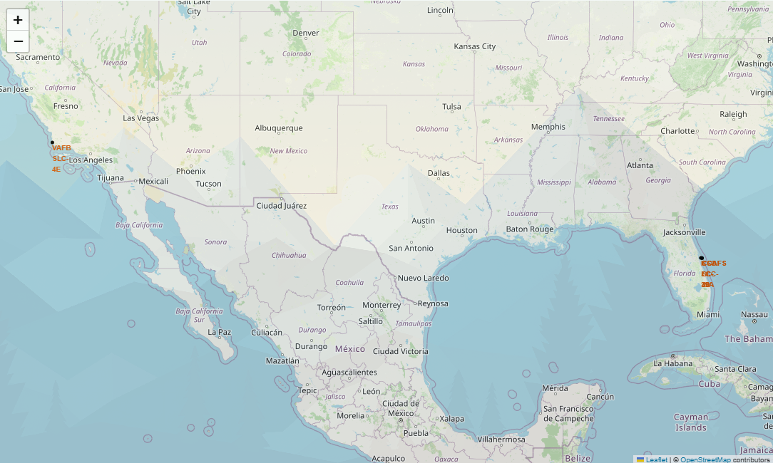
Folium Map: Launch Site Locations
This map shows the geographic locations of the four SpaceX launch sites in the USA. Markers pinpoint each site, providing a clear visual of their distribution (two in Florida, one in California).

Slide 35
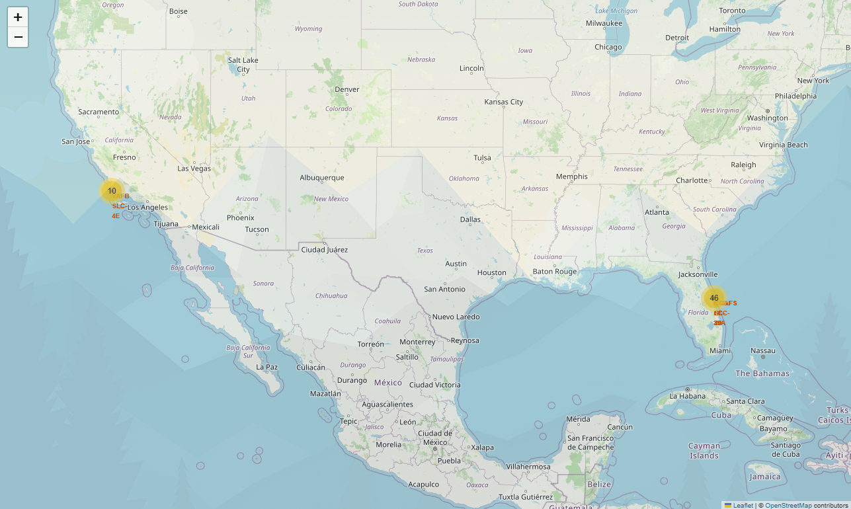
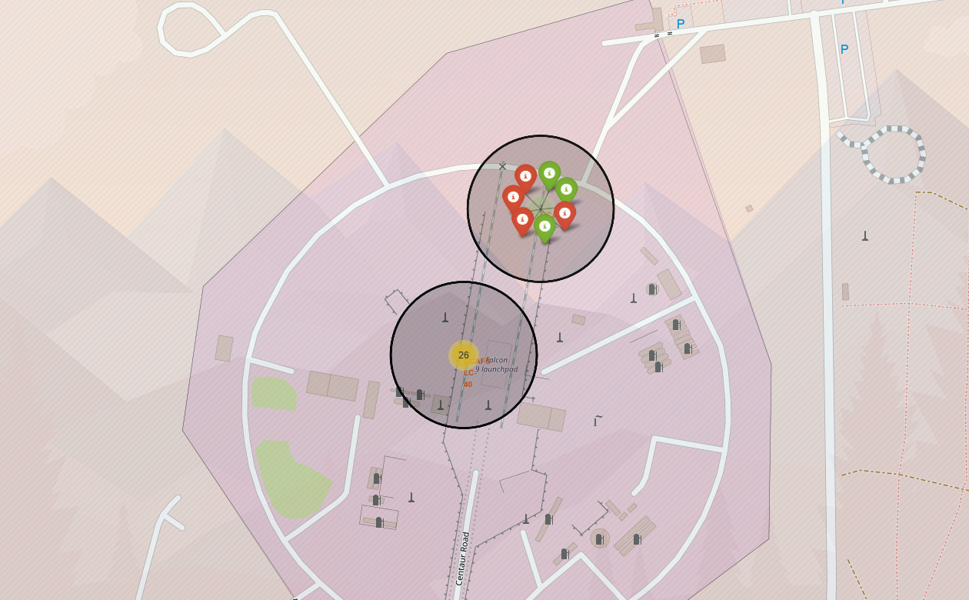
Folium Map: Launch Success/Failure at CCAFS SLC-40
This map visualizes launch outcomes at the CCAFS SLC-40 site. Green points indicate successful launches, while red points indicate failures. This allows for a quick visual assessment of a site's performance.

Slide 36
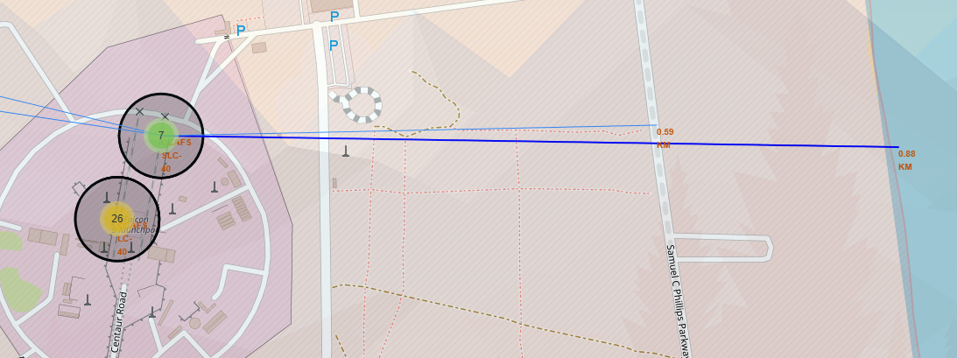
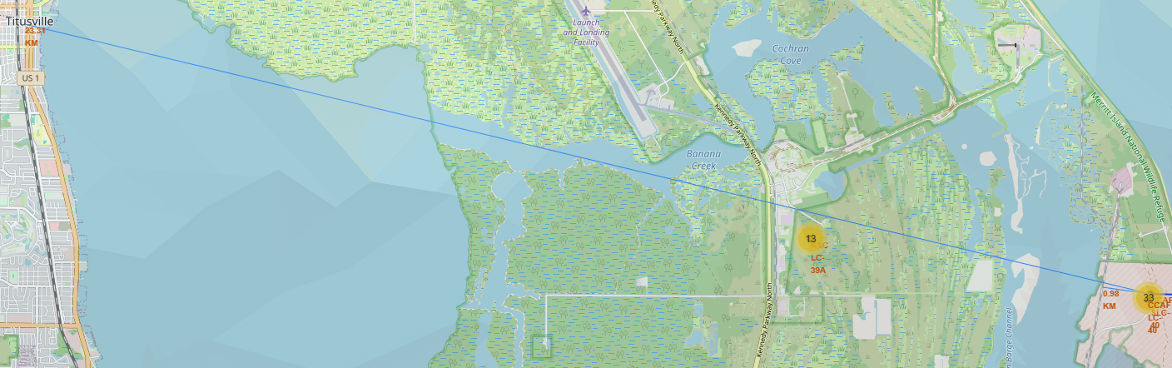
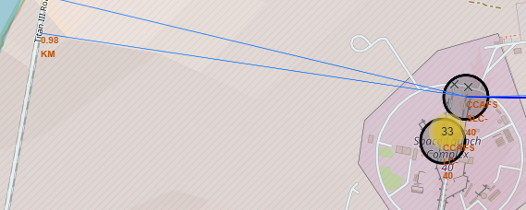
Folium Map: Proximity Analysis
The map shows the calculated distances from a launch site (e.g., CCAFSSLC-40) to the nearest coastline, railway, highway and city. This analysis is important for understanding logistical and environmental factors.

Slide 37

Section 4

Slide 38
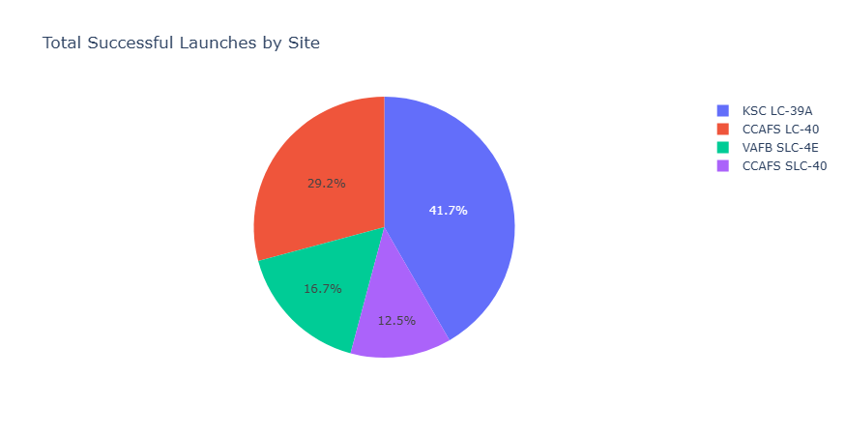
Total Successful Launches by Site

Slide 39
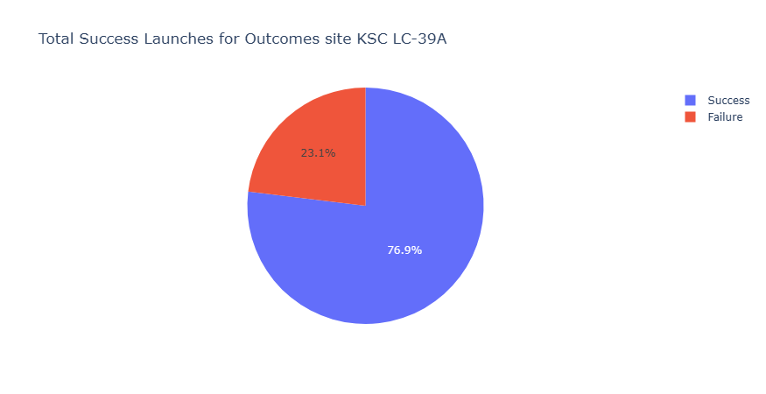
Launch Site with Highest Launch Success Ratio

Slide 40
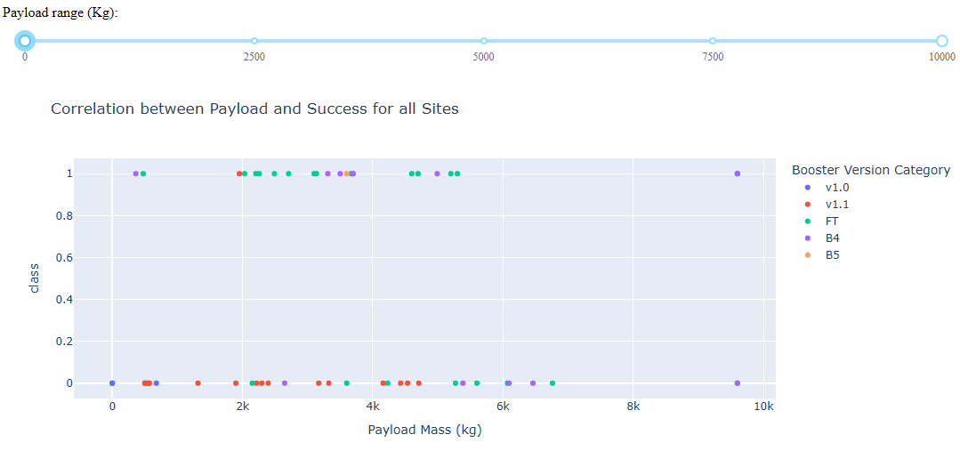
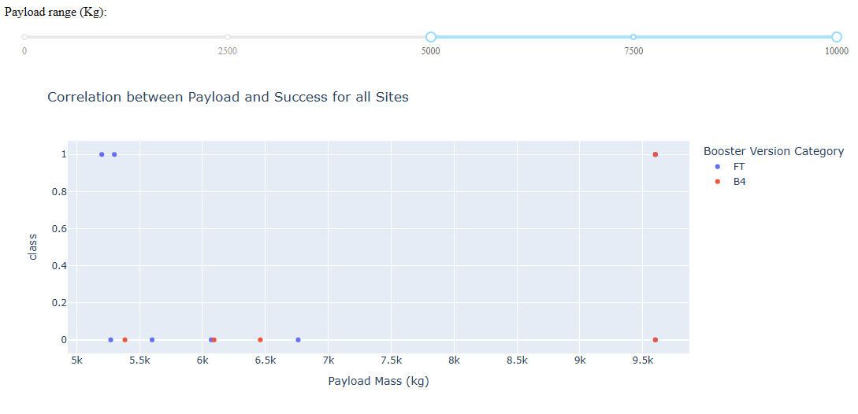
Payload Mass vs Launch Outcome for all Sites
As payload mass increases, the frequency of launches declines, yet success rates remain consistently high, particularly with newer booster versions (B5, FT, B4). This highlights SpaceX's strong proficiency in managing mid-to-heavy payloads with impressive reliability. The data indicates that the majority of successful launches originate from KSC LC-39A. While payload mass alone does not directly determine success, newer booster versions, notably B5, exhibit superior performance across a broad range of payload masses.

Slide 41

Section 5

Slide 42
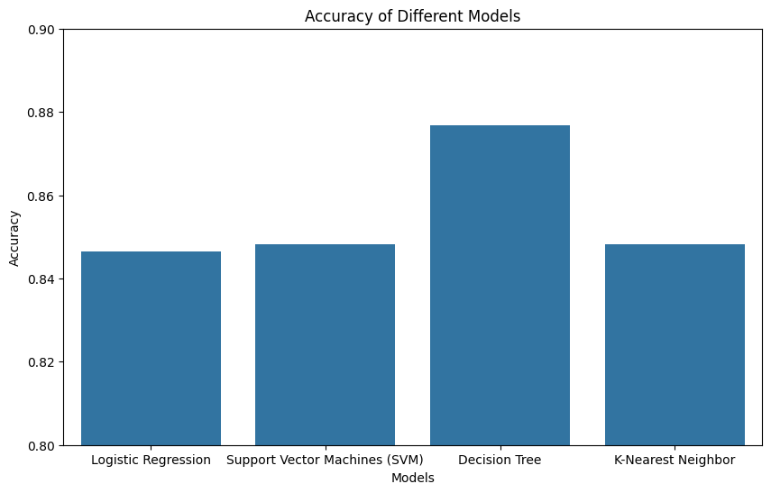
Classification Accuracy
This chart compares the test accuracy of the different classification models. The Decision Tree Classifier achieved the highest accuracy of approximately 87.5%.

Slide 43

Confusion Matrix
The confusion matrix for the best-performing model (Decision Tree) shows its predictive power. It correctly predicted 10 out of 12 successful landings (True Positives) and 5 out of 6 unsuccessful landings (True Negatives). There was 1 False Positive and 2 False Negatives. This visualization helps in understanding the types of errors the model makes.

Slide 44
Conclusions
Launch outcomes are significantly influenced by factors like the orbit type, payload mass, and launch site.
Certain orbits (like GEO, HEO, SSO) have demonstrated higher success rates.
The Decision Tree classification model proved to be the most accurate for predicting Falcon 9 first-stage landing success in this analysis.
Interactive tools like Folium maps and Plotly dashboards are highly effective for exploring and communicating complex launch data.

Slide 45
Appendix
Github Repository with all the notebooks and details: Bilhao/IBM-Data-Science

Slide 46


